Slide 1
Online Quiz
Presented by
Sumaiya Khan
Roll:2007031
MD .Kawsar Mahmud Khan
Roll:2007046

Slide 2
MAIN FEATURES
Splash Screen
Seamless Authentication
Quiz Test
Interactive Quiz Sharing
Global Leaderboard
Quiz History & Analytics
Profile Editing

Slide 3
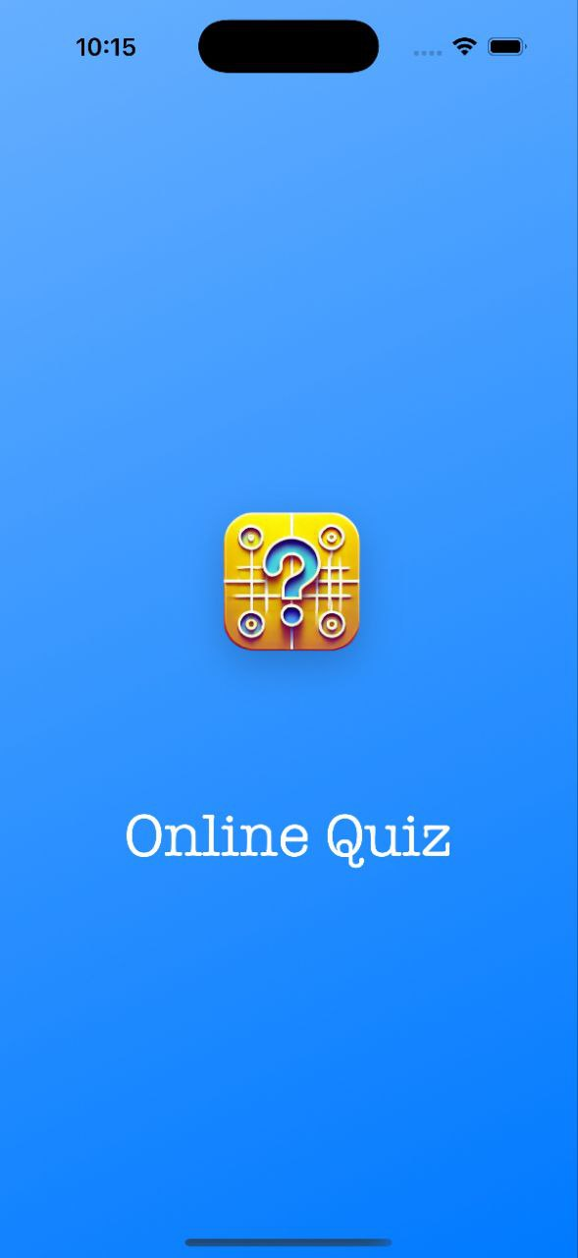
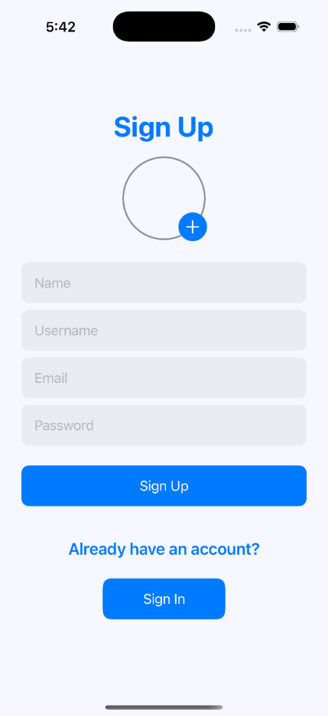
AUTHENTICATION
Firebase Authentication Secure and efficient login, sign-up, and password reset powered by Firebase, ensuring reliability and user trust.
Swift UI Interface Clean and intuitive design with simple forms for effortless navigation and a modern user experience.

Slide 4
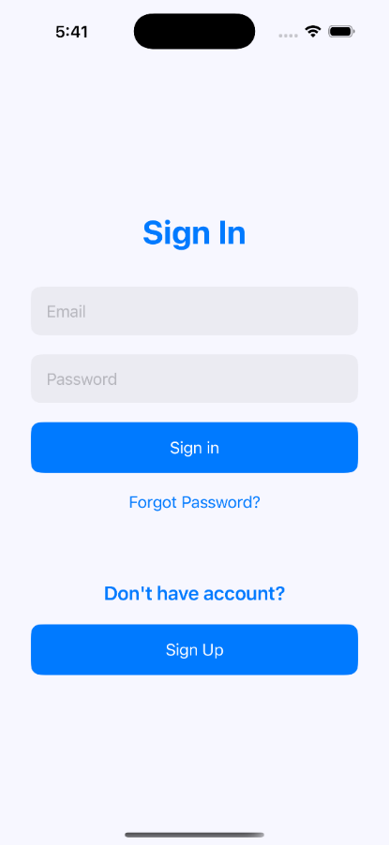
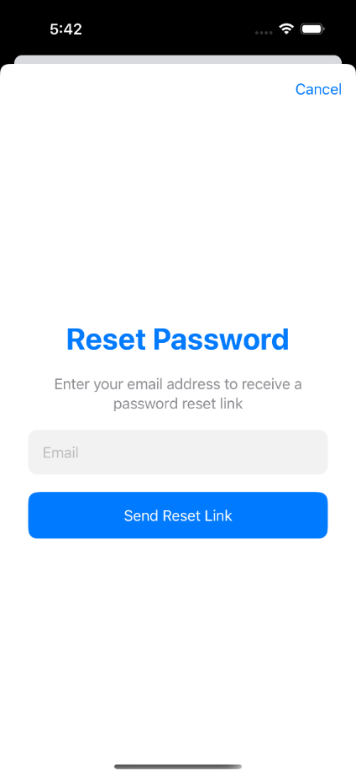
Password Reset & Image Picker
Implemented a user-friendly password reset interface and integrated an Image Picker using the delegate pattern with a SwiftUI sheet for seamless interaction.

Slide 5
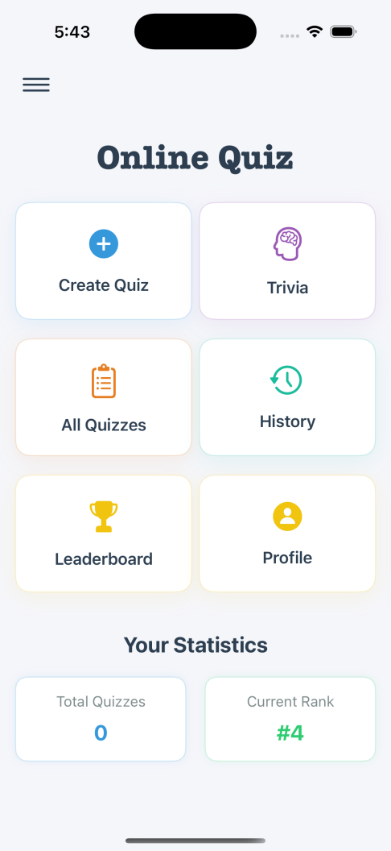
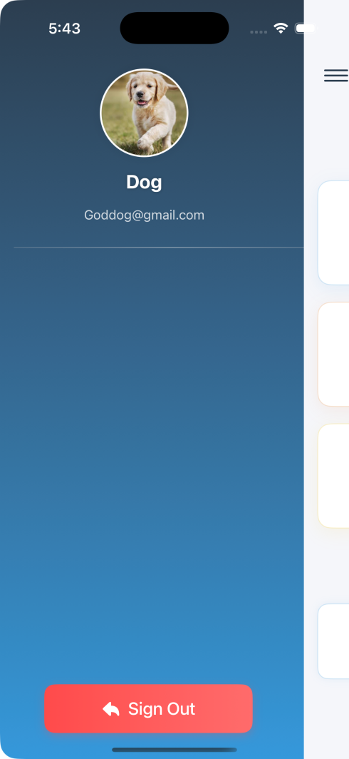
HOME PAGE
Home screen serves as a hub, showing user stats like quizzes taken and leaderboard rank, with navigation to quizzes, history, and profile.
The sidebar ensures a clean and intuitive user experience by offering quick access to key features without cluttering the main interface

Slide 6
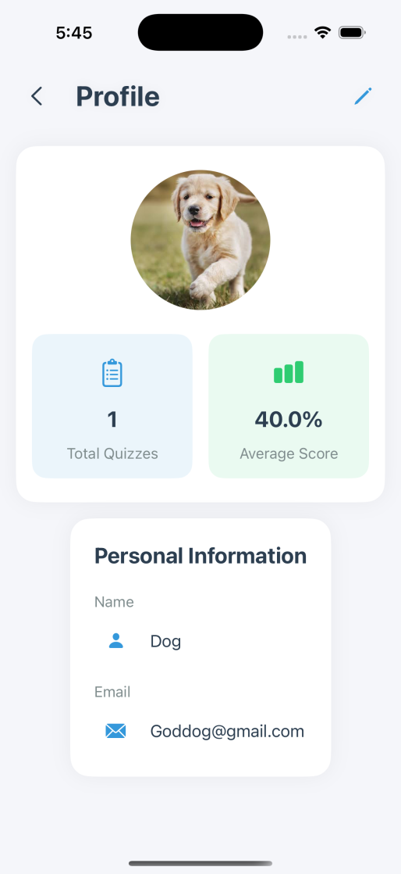
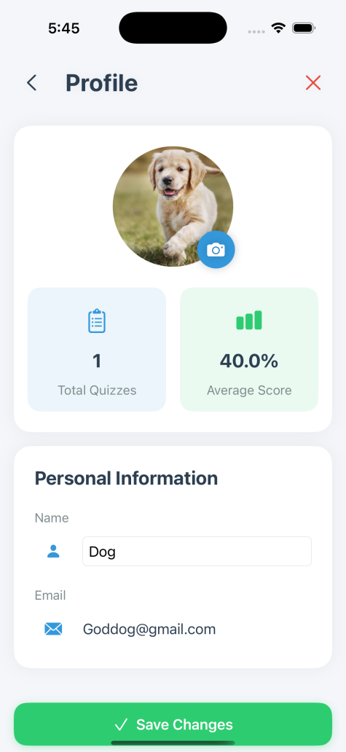
Profile Page
Profile Display
The profile page displays the user's image and details, including name, email, and other information.
Editable Features Users can update their profile picture and name directly from the profile page.

Slide 7
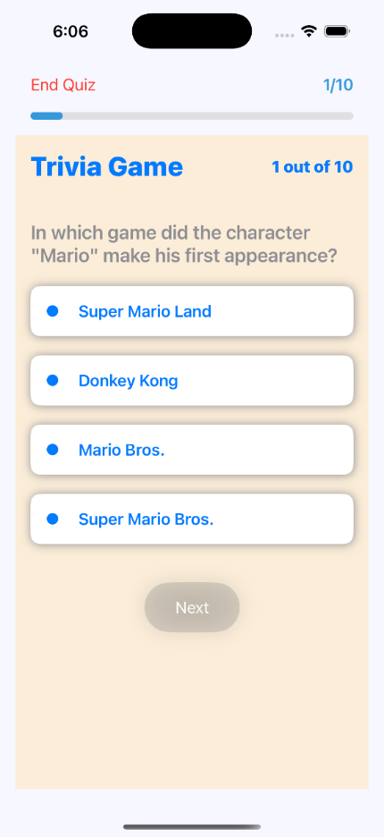
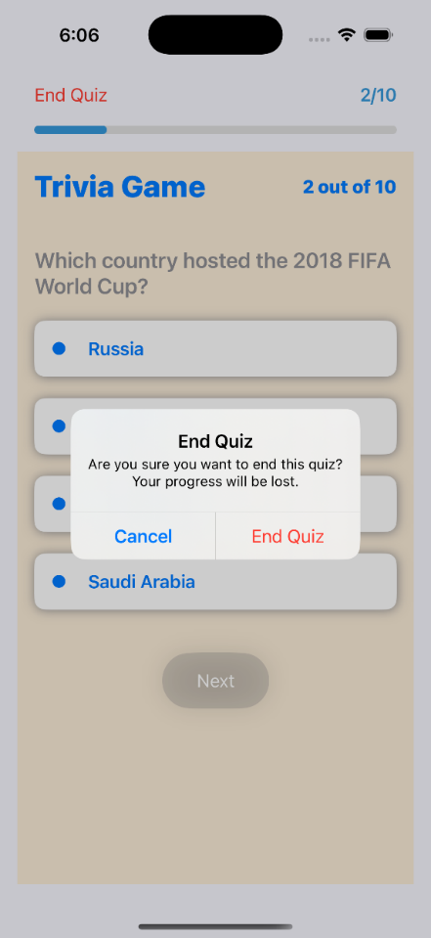
QUIZ TEST
Dynamic Question Fetching
Questions are fetched dynamically and displayed in an engaging format, ensuring a fresh experience every time.
Cancel Anytime Users can cancel the quiz at any point, and progress will not be saved in the history.

Slide 8
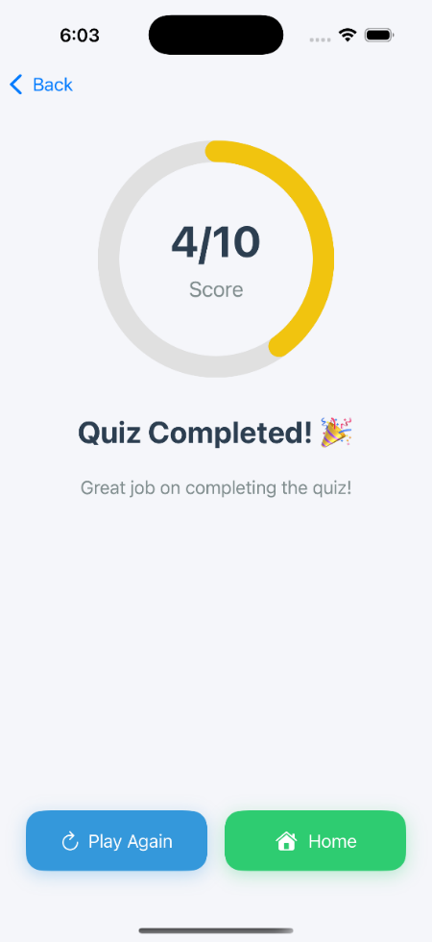
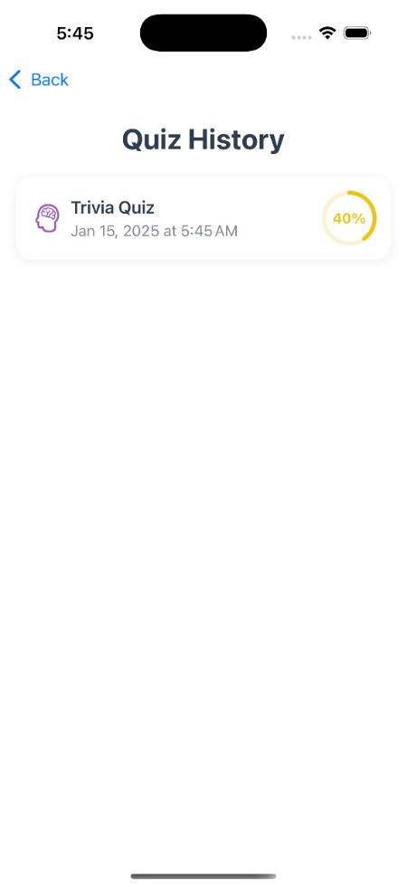
TEST COMPLETION
Results & Achievements Upon completion, a results page is shown with the final score, celebrating the user’s success.
Quiz History
tracks completed quizzes with titles, timestamps, and scores, helping users monitor progress and improve.

Slide 9
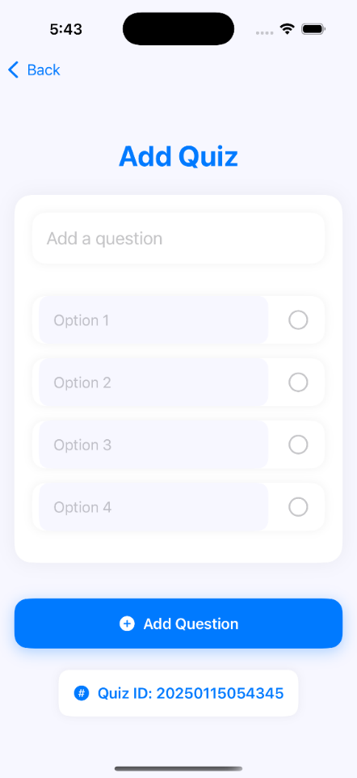
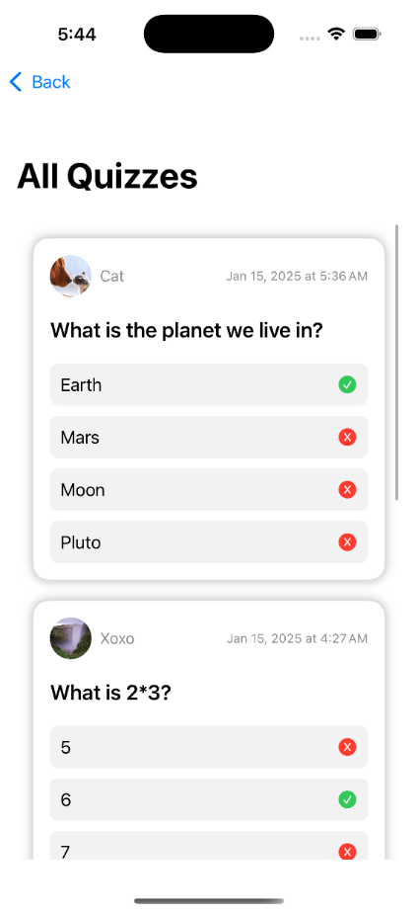
INTERACTIVE QUIZ SHARING
Users can upload custom questions, which are stored in Firebase and displayed on the "All Quizzes" page. These questions are accessible to all users, fostering a collaborative and engaging quiz environment..

Slide 10
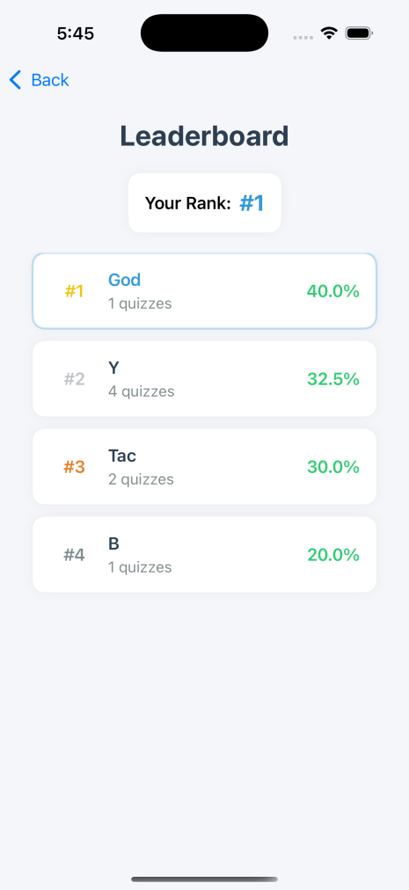

LEADERBOARD AND HISTORY
The app lets users track their performance with detailed history logs and ranks them on the leaderboard based on scores and participation. This fosters a competitive yet engaging environment.

Slide 11
ANY QUESTIONS…?? THANK YOU

